Slide 1

Predictive Analytics for Community Blood Supply Optimization ACE Project
By: Afolarin Faluyi

Slide 2
Partnership Plan
The plan is to be partnered with the Huntsville Regional Health Center. With the plan of transforming raw donor logs into a predictive tool to prevent blood shortages in the Walker County area.

Slide 3
Problem Statement
Recently the Huntsville center faced "Emergency Appeals" due to unpredictable blood supply and a 20% "churn rate" (donors who donate once and never return).
The solution I believe I can supply by using Python to identify at-risk donors before they lapse.

Slide 4
Data Ethics & Privacy
I implemented a "Hashing & Dropping" pipeline. Names and Phone numbers were removed before analysis. I used donor_id for tracking without compromising identity.

Slide 5
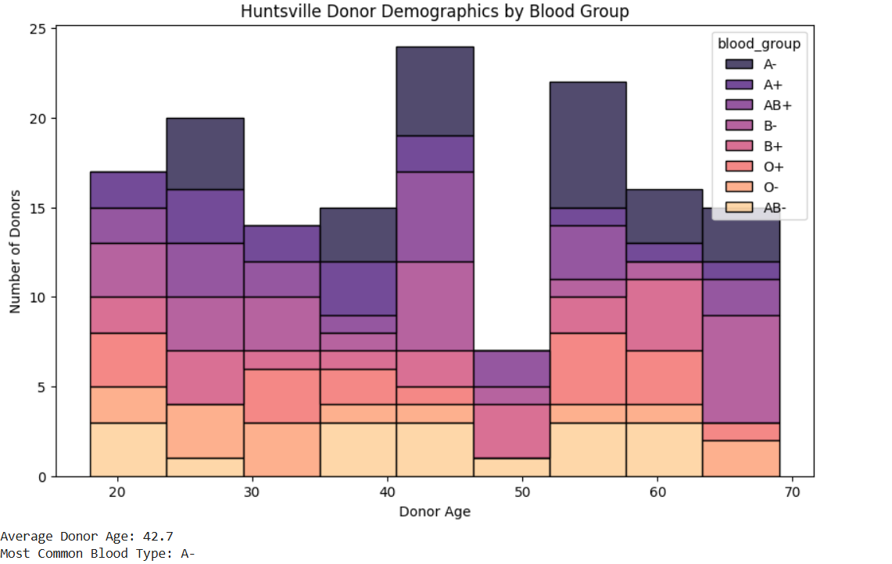
Donor Demographics

Slide 6
Recommendations
Point 1: Relocate mobile units to campus during midterms (high engagement).
Point 2: Implement an Blood specific "Hero Alert."

Slide 7
Conclusion
In conclusion this details can be used to save lives because all the data will be organized neatly for the blood bank to use.

